Slide 1
Initial plan
Crossing ship
Merge into shippping lane
Complex situation
Speed-up and to starboard
Slow down and bold to port

Slide 2
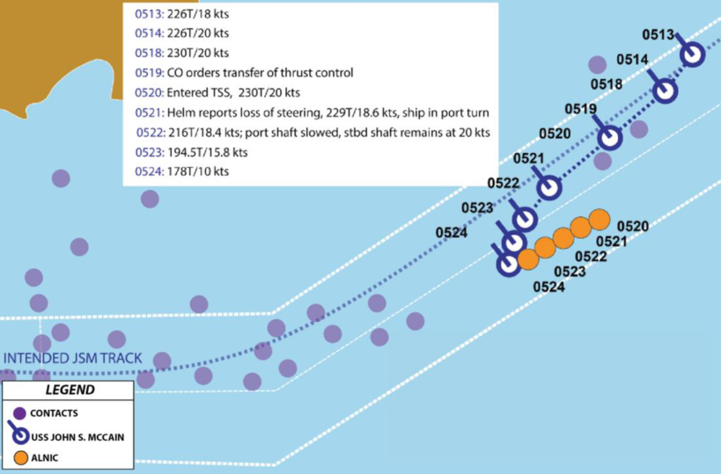

Slide 3
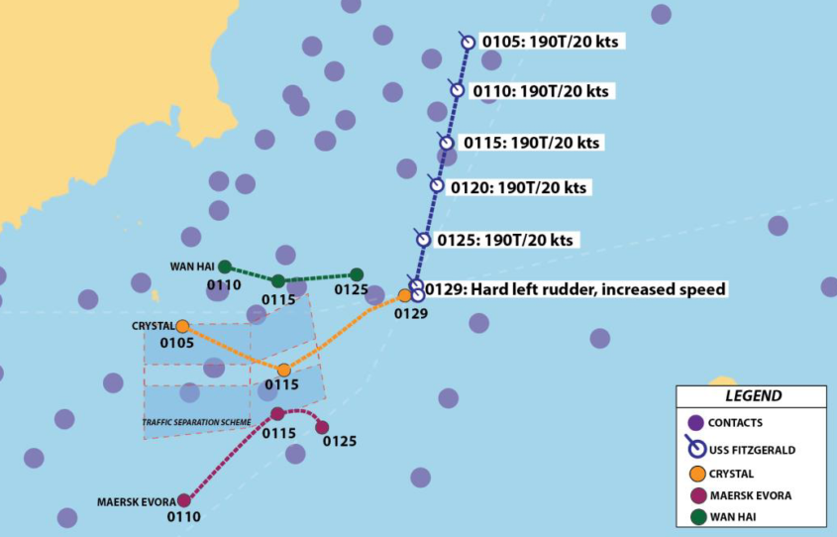

Slide 4
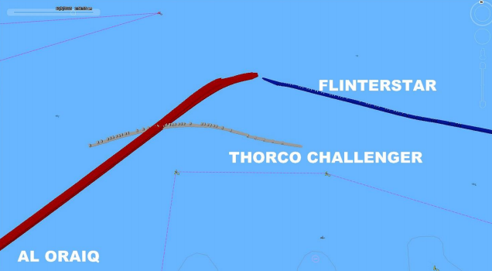

Slide 5
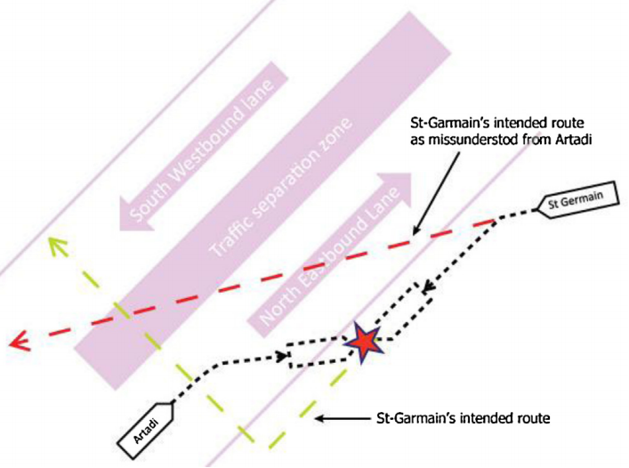

Slide 6
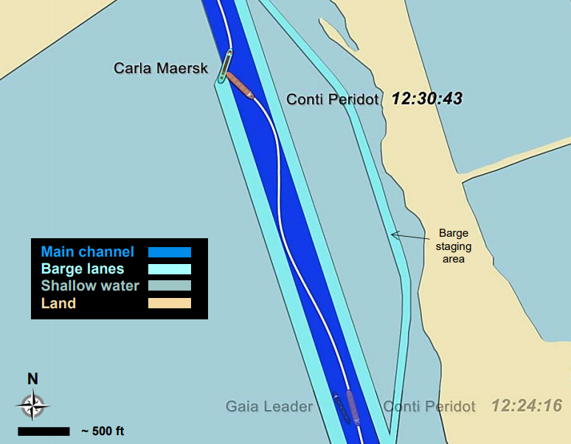

Slide 7
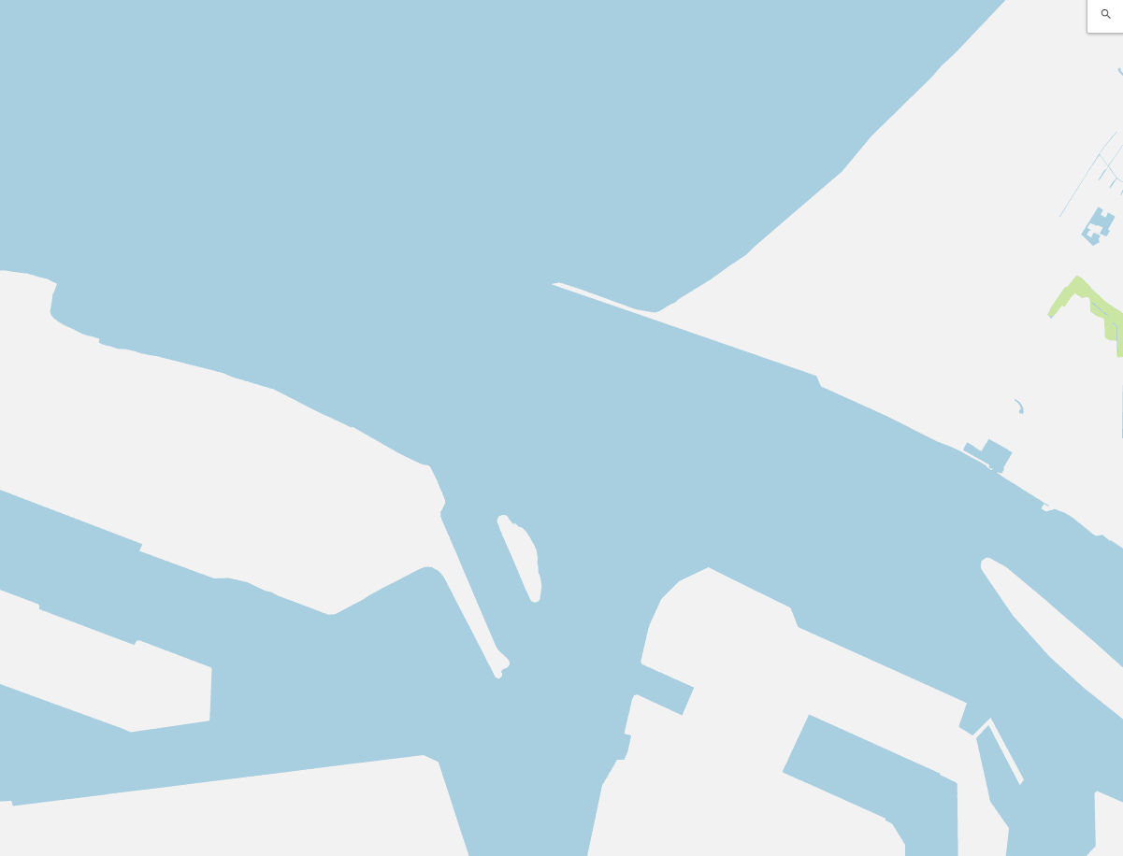
North sea
Maasgeul
Maasgeul
Berghaven
Yangtzekanaal
Nieuwe waterweg
Calandkanaal
Beerkanaal
1 km
1 cm = 0.255 km
3.914 cm = 1 km
Schepen 2x vergroot

Slide 8
North sea
12:00
Maasgeul
Astrorunner
13.4 kn
Anglia Seaways
10.3 kn
Berghaven
Yangtzekanaal
Nieuwe waterweg
Gulf Valour
7.8 kn
Calandkanaal
Beerkanaal
1 km
*Ships scaled with factor 2 for visibility
1 cm = 0.255 km
3.914 cm = 1 km
Schepen 2x vergroot

Slide 9
North sea
12:00
Maasgeul
Astrorunner
13.4 kn
Berghaven
Anglia Seaways
10.3 kn
Yangtzekanaal
Nieuwe waterweg
Gulf Valour
7.8 kn
Calandkanaal
Beerkanaal
1 km
*Ships scaled with factor 2 for visibility
1 cm = 0.255 km
3.914 cm = 1 km
Schepen 2x vergroot

